Slide 1
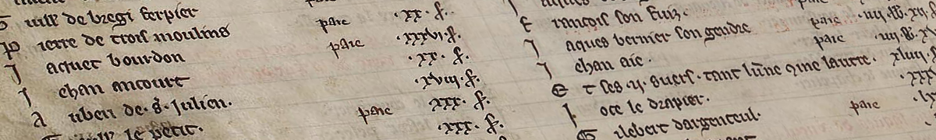
The TAX Rolls of Medieval Paris
https://taxrolls.github.io
Nathan A. Daniels
Johns Hopkins University
@nathanadaniels

Slide 2
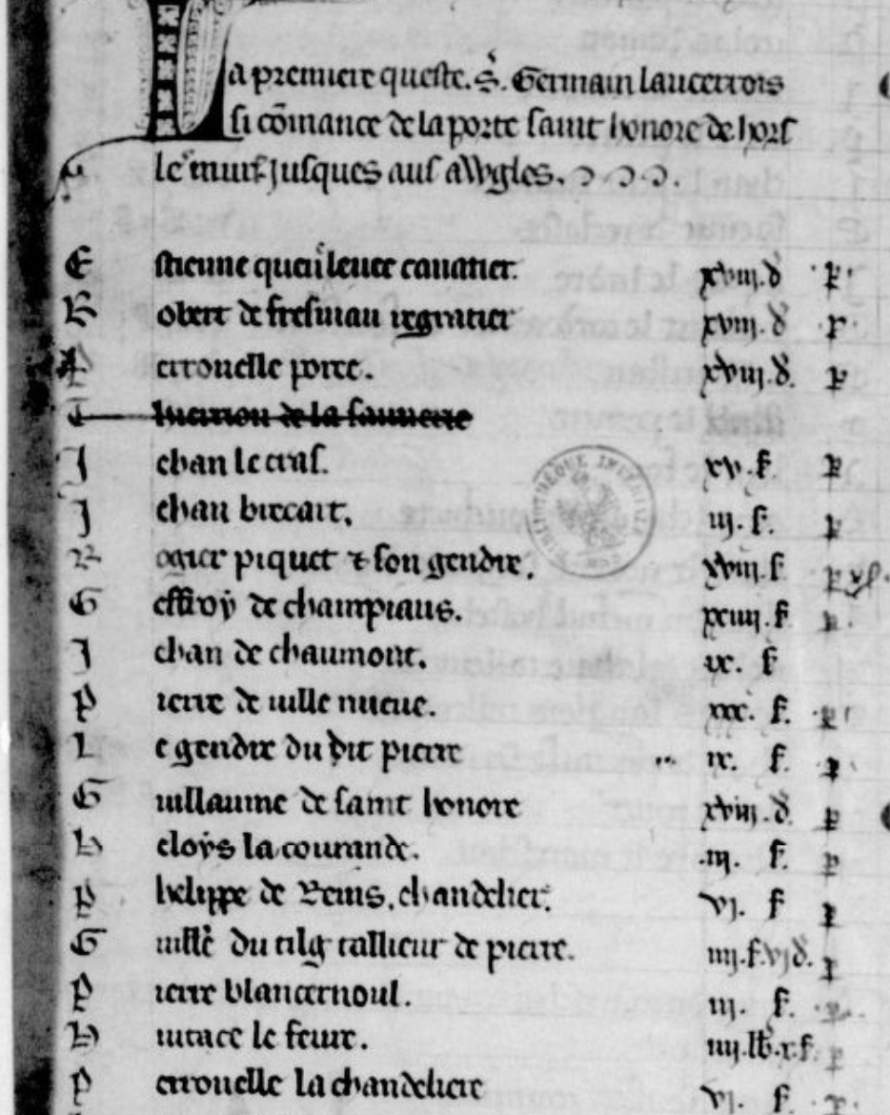
Manuscript Data
People
Names
Given, Occupational, Toponym, ??
Occupations
Taxes Owed and Paid
Relationships: Familial & Professional
Topography
Bureaucratic Organization
Population Density
Income Distribution

Slide 3
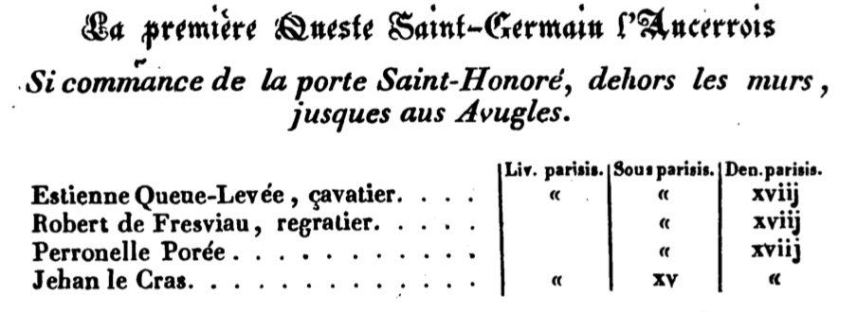
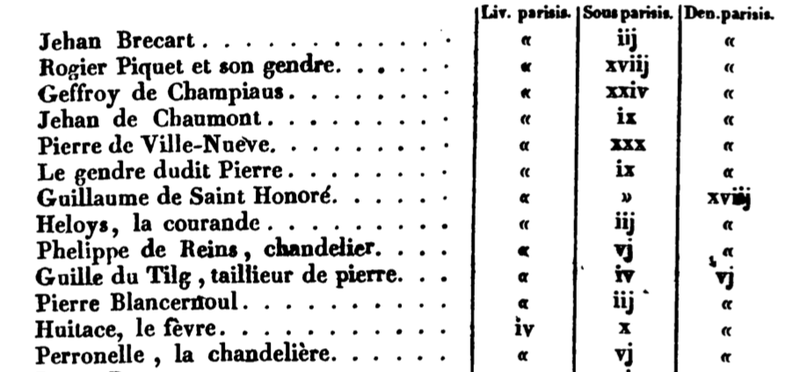
Manuscript vs Published

Slide 4
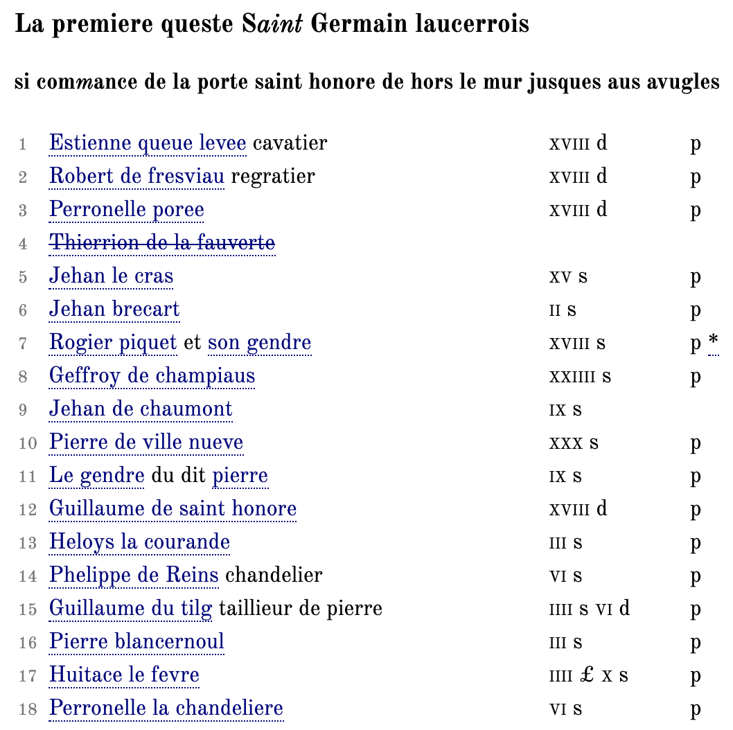
Manuscript vs Digital Edition

Slide 5
Sample TEI Markup
Bertaut de compiegne poullaillier ii.s.vi.d p.
<item>
<persName ref="#BC01">
<forename>Bertaut</forename>
<nameLink>de</nameLink>
<surname>compiegne</surname>
</persName>
<roleName ref="#BC01" role="poulailler"
type="occupation">poullaillier</roleName>.
<measureGrp>
<measure quantity="2" unit="sous">ii.s.</measure>
<measure quantity="6" unit="deniers">vi.d</measure>
</measureGrp>
<seg type="status">p.</seg>
</item>

Slide 6
Transaction Markup
Bookkeeping Ontology by Digital Edition Publishing Cooperative for Historical Accounts (DEPCHA) (bit.ly/30Wr9bd)
Uses @ana to provide markup for RDF
<rs ana="#bk:to">Le roi de France</rs>
<date ana="#bk:when">1313</date>
…
<item ana="#bk:entry">
<persName ana="#bk:from" ref="#PP01">Perronelle poree</persName>
<measure ana="#bk:money" quantity="2” unit="sous">ii.s.</measure>
<seg ana="#bk:status">p.</seg>
</item>
Result: Transaction from Perronelle poree to Philip IV, paid 2 sous in 1313

Slide 7
-ographies
Use XSLT (eXtensible Stylesheet Language Transformations) to extract and compile structured XML data from TEI-encoded documents
Create separate XML documents for:
Individual People / Biographical Data (Personography)
Places (Gazetteer)
Financial Records (Transactionography)
Compile information about:
Names (Given / Topographical)
Occupations
Etc.

Slide 8
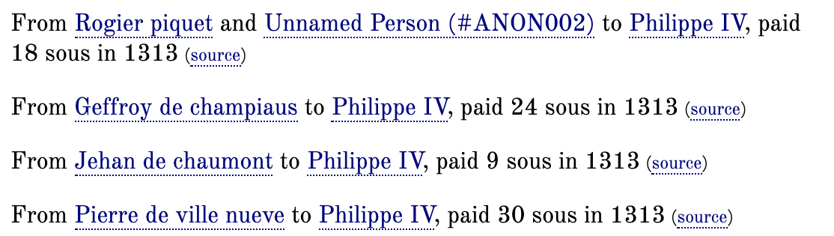
-ographies
Transactionography
<event type="#bk:entry" xml:id="trans_d2e563" source="#item_wc5_2zg_ghb">
<desc type="#bk:when">1313</desc>
<desc type="#bk:from" corresp="#GSH01">Guillaume de saint honore</desc> <desc type="#bk:to" corresp="#P04”/> <desc type="#bk:money"> <measure commodity="currency" quantity="18” unit="deniers”/> </desc> </event>

Slide 9
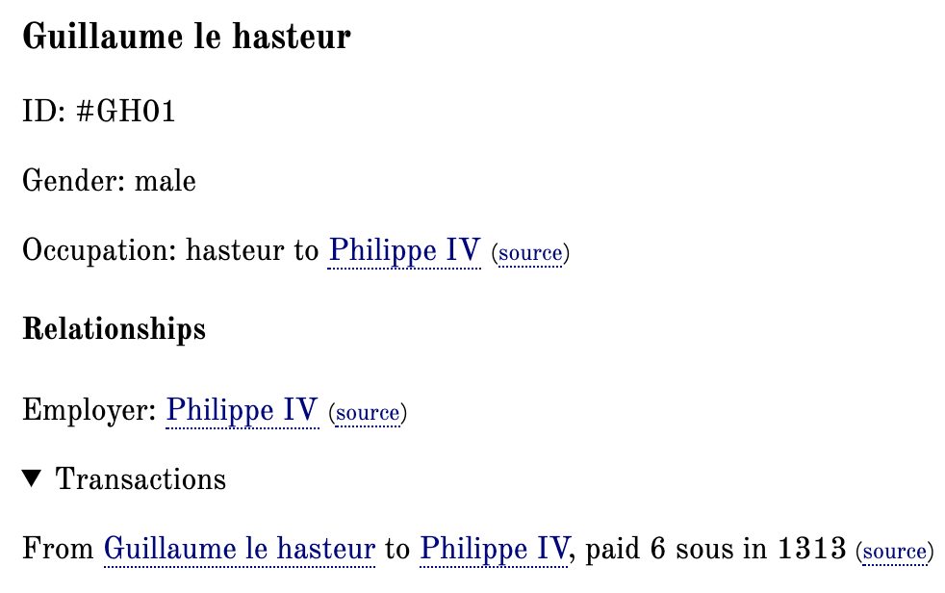
-ographies
Personography
<person xml:id="GH01"> <persName source="#item_m25_2zg_ghb" when="1313"> <forename>Guillaume</forename> <nameLink>le</nameLink> <roleName>hasteur</roleName> </persName> <sex value="male"/> <occupation source="#item_m25_2zg_ghb" when="1313" role="hasteur"> <desc type="source">hasteur</desc> <desc type="reg">hasteur to <persName ref="#P04">Philippe IV</persName> </desc> </occupation> </person>

Slide 10
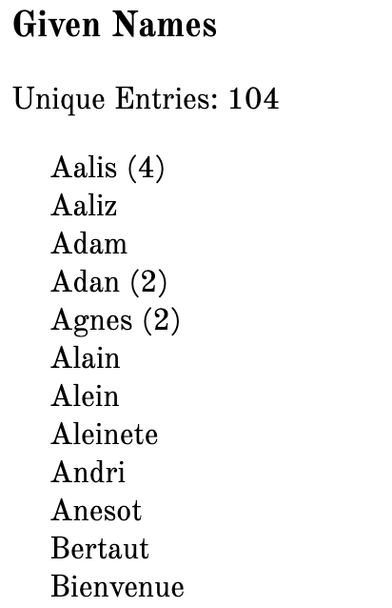
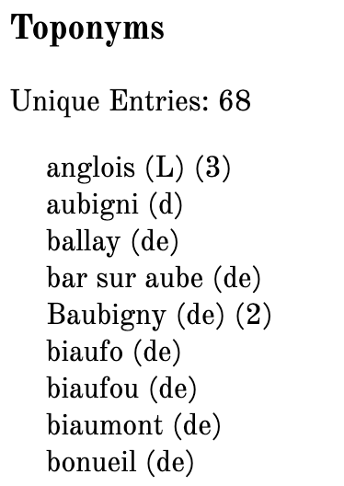
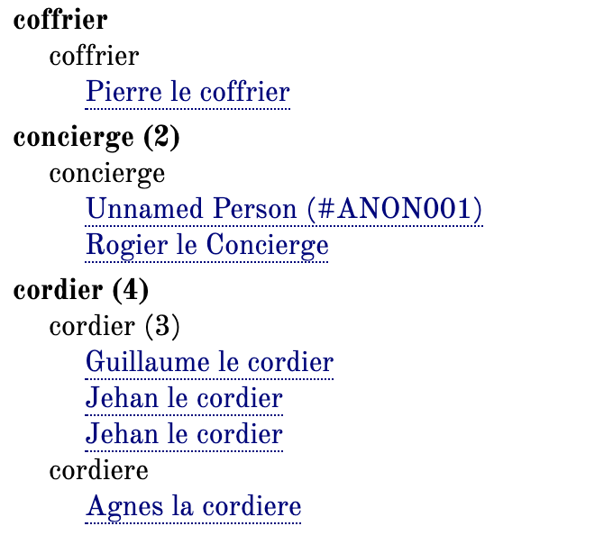
-ographies
Occupationography Onomatography?

Slide 11
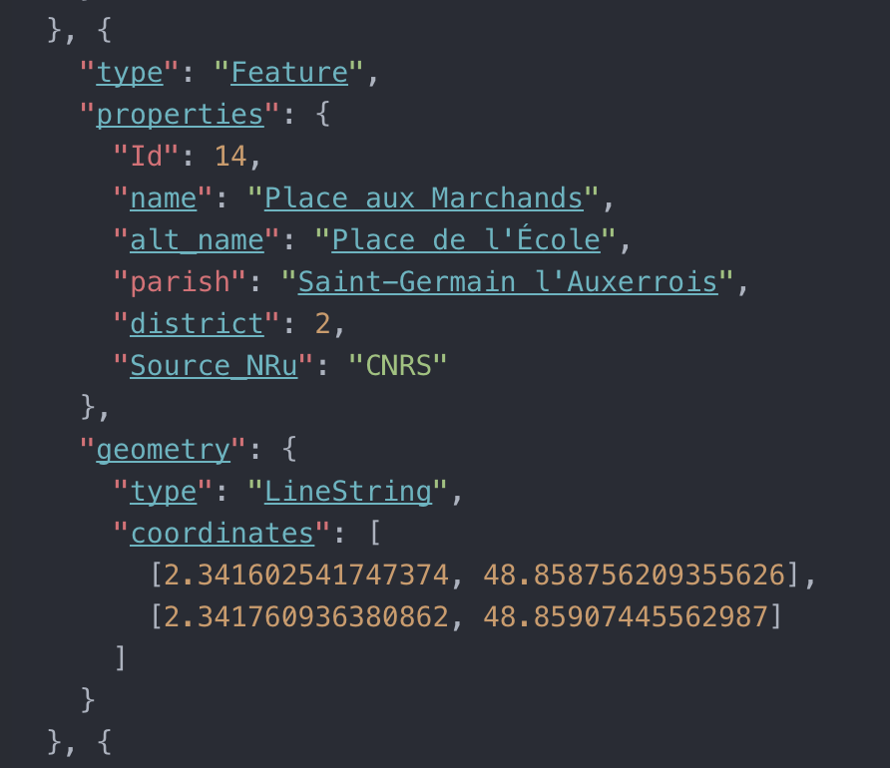
What’s next?
Continued dev’t of Personography
Geo-locating ALL THE THINGS
E.g. Creating a gazetteer
Existing Models:
Pelagios Network / Recogito
World Historical Gazetteer
Mapping & Visualization
Search/query/backend/API?
Linked Open Data
Data Entry…
Automated encoding?

